Slide 1
Advanced Robotics Activity About the Students
Juniors, Seniors, Graduate Students in Biomedical, Computer, Electrical, Mechanical, Software Engineering and Computer Science
Some students in robotics minor, robotics club or FIRST Robotics team mentors
Take courses in controls, mechatronics, microcontrollers, embedded systems, artificial intelligence, computer vision, image processig
Carlotta A. Berry, PhD

Slide 2
Advanced Robotics Activity About the Course
Flipped Course – lectures on YouTube, weekly quizzes on Moodle based upon lectures, weekly reading of literature review
Labs completed in teams of 2. May take to two weeks dependent on difficulty.
Lab memos and code due every Sunday after completing demos
Final Project on path planning, localization, and mapping
Carlotta A. Berry, PhD

Slide 3
Advanced Robotics Activity Avoid-Obstacle
Create an obstacle avoidance behavior on the mobile robot
Use potential fields to create the collide and avoid behaviors (shy kid, aggressive kid)
Create a random wander behavior with obstacle avoidance
Upgrade go to goal behavior with obstacle avoidance use IMU or encoders
Carlotta A. Berry, PhD

Slide 4
Robot Control Spectrum
1960 1980 1990
Deliberative (AI) Behavior-Based Control Hybrid Control
Notes:
Paradigms for organizing robot intelligence
A paradigm is a philosophy or set of assumptions and/or techniques which characterize an approach to a class of problems. There are three paradigms for organizing intelligence in robots hierarchical, reactive (behavior-based) and hybrid deliberative/reactive
http://www.smashingrobotics.com/design-concepts-and-control-of-automatic-systems/
http://www.smashingrobotics.com/standards-and-classifications-of-industrial-robots/

Slide 5
3 Robot Primitives
SENSE
Sensed information
Sensor data
Information (sensed or cognitive)
PLAN
Directives
ACT
Sensed information or directives
Actuator commands

Slide 6
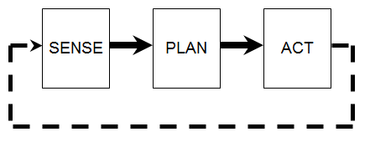
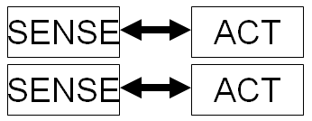
Robot Control Paradigms
Hierarchical (1967) – very slow
Reactive (1986) – no planning
PLAN
SENSE
ACT
SENSE
ACT
SENSE
ACT
Hybrid Deliberative/Reactive (1990)
Notes:
Hierarchical – oldest paradigm, top-down fashion, heavy on planning, very slow, I see a door, I decide to head toward it, I plot a course through the chairs, people have default schemas and behaviors, sensing data in one global world model, SENSE-PLAN-ACT (S-A)
Reactive – based upon cognitive psychology and biology, examine living examples of intelligence, threw out planning, the input to an act is the direct output of a sense, multiple instances of sense-act couplings in parallel, these concurrent processes are behaviors, move forward, reach a goal, turn 90 degrees, stimulus-response training in animals, B. F. Skinner, fast execution time, SENSE-ACT (S-A)
Hybrid Deliberative/reactive – plans then decomposes a task into subtasks, then the robot executes like the reactive paradigm, Plan, Sense-Act (P, S-A)

Slide 7
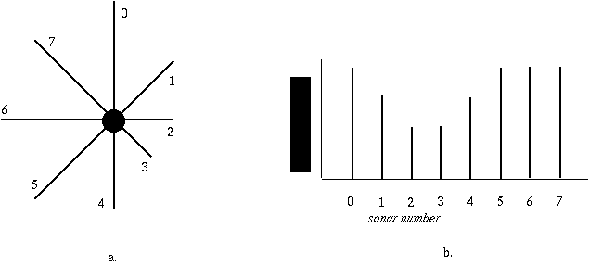
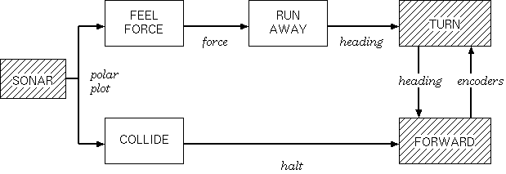
Perception Polar Plot
Avoid-Obstacle
Notes:
Perception Polar Plot
The perception plot is egocentric to eliminate a need for memory representation
Sonar 2 and 3 indicate that there is a wall and no need for memory or reasoning

Slide 8
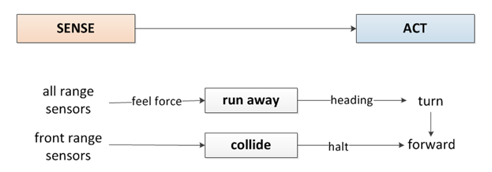
Level 0: Avoid Obstacle
Reactive Control
No PLAN
Shy
Kid
Aggressive Kid
Notes:
Most basic type of control architecture, reactive control is the robot senses and then immediately acts.
This can transition to behavior based control when the behavior is time extended such as wall following or obstacle avoidance.

Slide 9
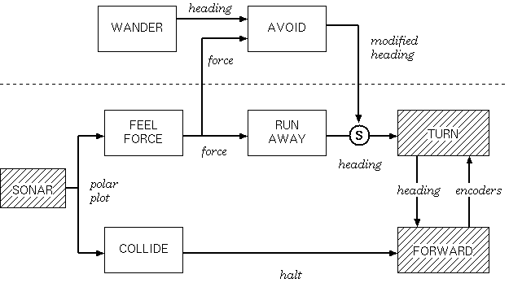
Level 1: Wander
Notes:
Level 1: Wander

Slide 10
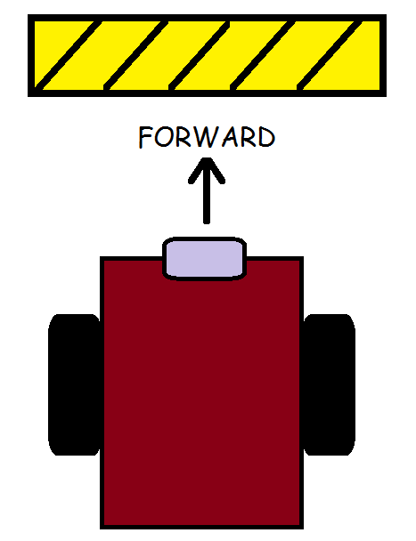
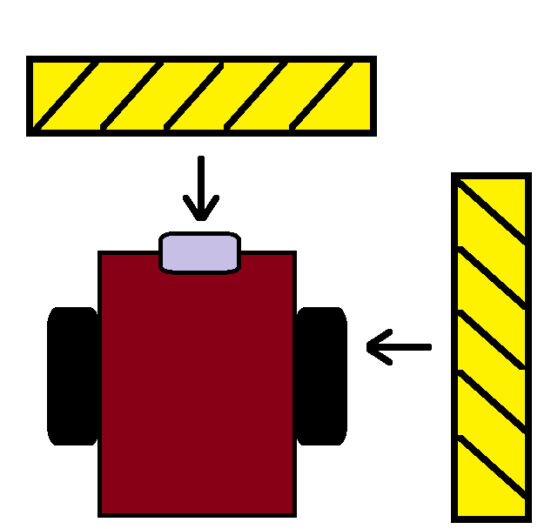
Example
Collide Behavior
Aggressive Kid
RunAway Behavior
Shy Kid

Slide 11
Control Schemes
Bang-Bang (On-Off)
Collide Behavior
Proportional
Run Away Behavior
Controller turns ON when the error is in a given band, stops motor
Controller turns OFF when the error is outside the given band, motors on
Controller is always on but responds proportional to amount of error. The closer the obstacle, the faster the motor moves.
The robot turns proportional to the IR sensors triggered

Slide 12
Feedback Control Schemes

Slide 13
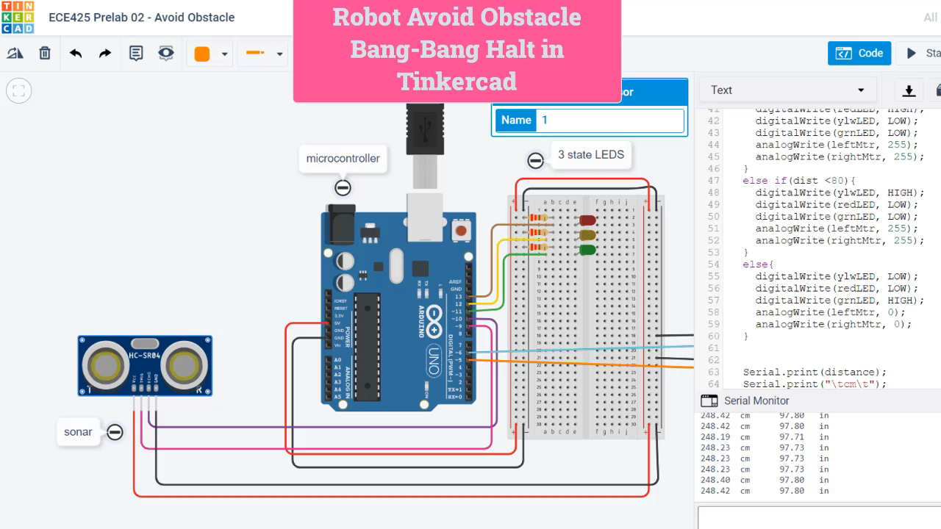
TinkerCad Simulation

Slide 14
Avoid Obstacle State Diagram
STATE TRANSITION TABLE
state | input | next state
Avoid (RunAway) Red Danger | Really close to obstacle | Collide
Avoid | No obstacles | Random Wander
Random Wander Green | Close to Obstacle | Avoid
 | Really Close to Obstacle | Collide
Collide (Halt) Warning Yellow | Really Close to Obstacle | Avoid
Use red, green, yellow LEDS to show robot state

Slide 15
Activity A.1
Create a random wander behavior
Generate a random number that represents distance in cm or angle in degrees
Modify the robot’s drive function to move forward a random number of cm
Modify the robot’s turn function to turn a random number of degrees

Slide 16
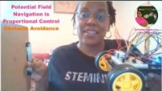
Potential Field Navigation & Proportional Control for Obstacle Avoidance

Slide 17
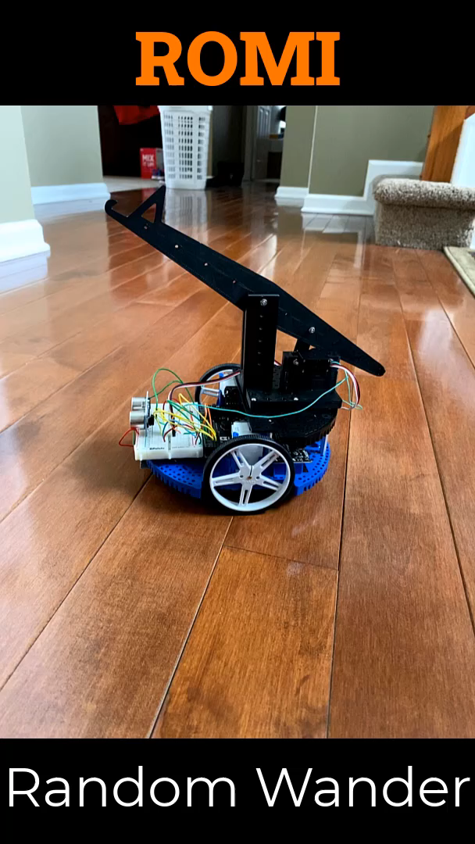
Random Wander

